Slide 1
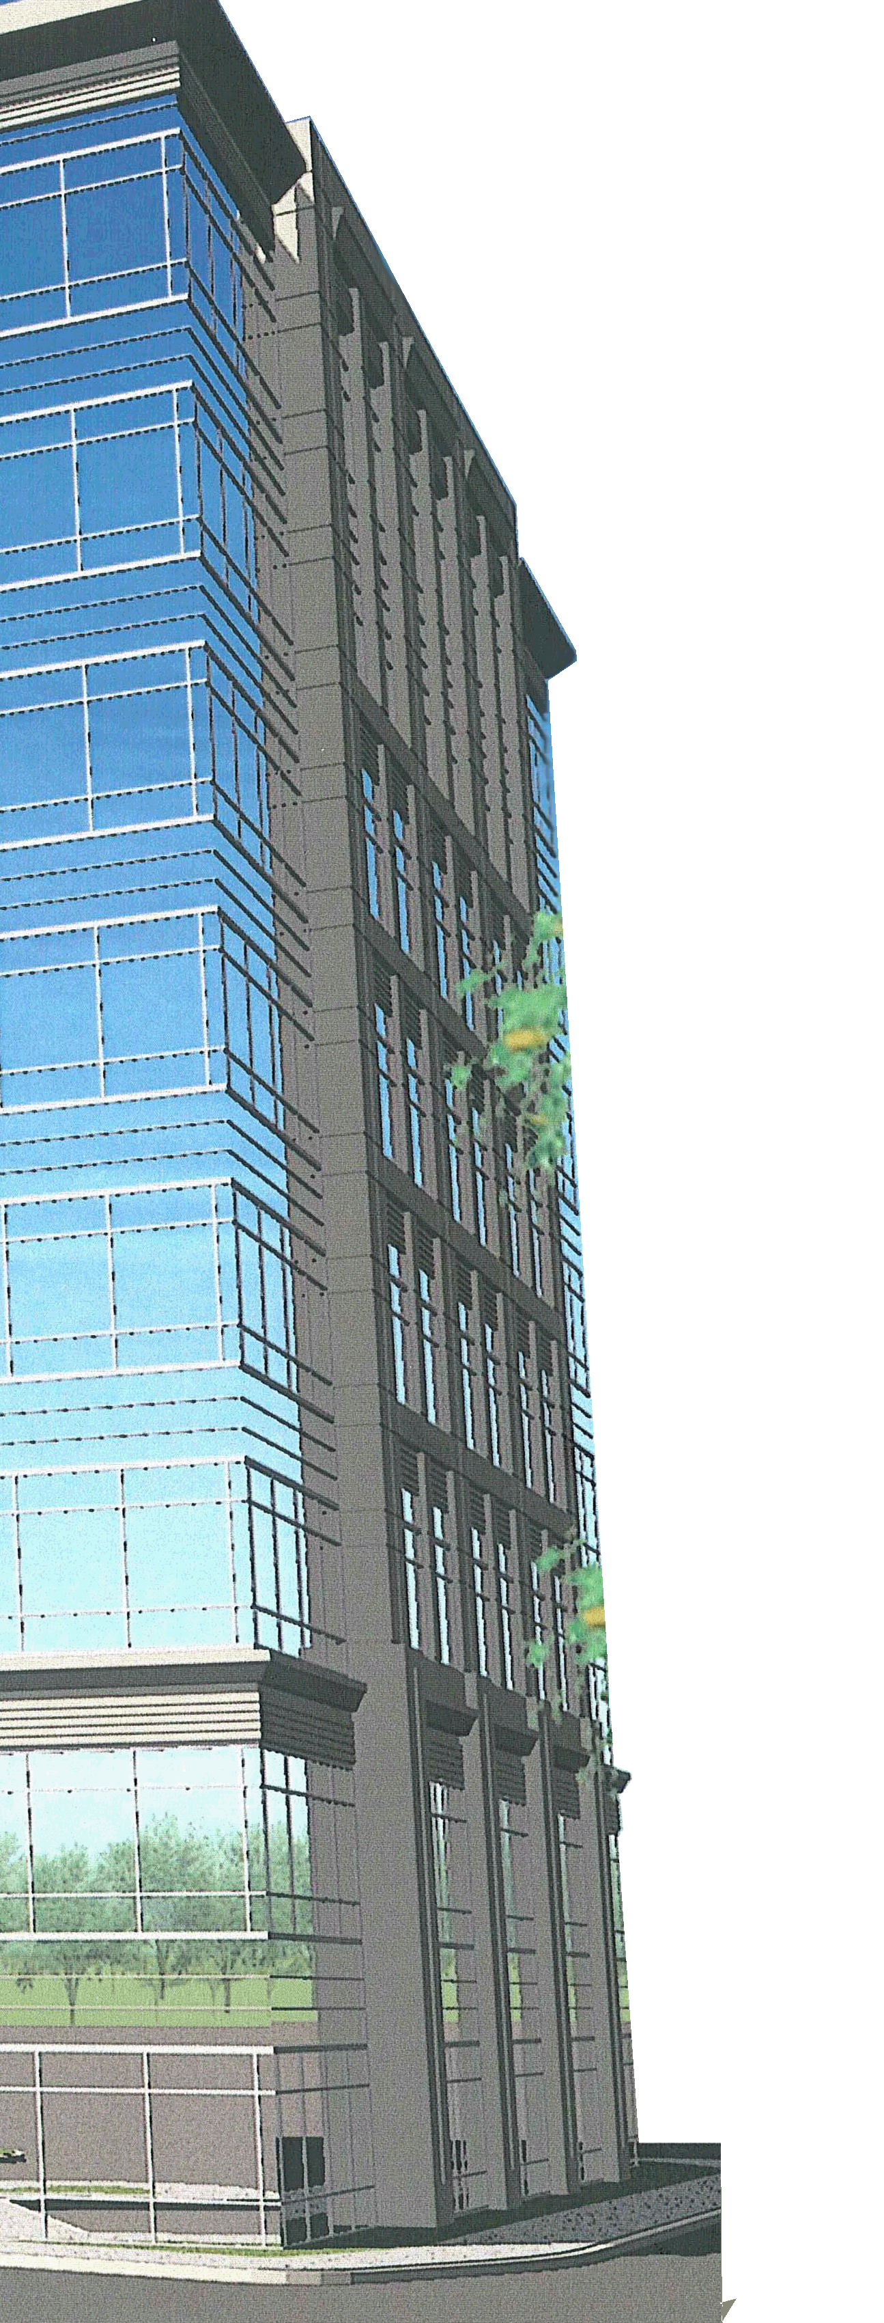
Washingtonian Center
Lee Ressler April 15, 2008 Faculty Advisor: Dr. Memari
Final Thesis Presentation

Slide 2
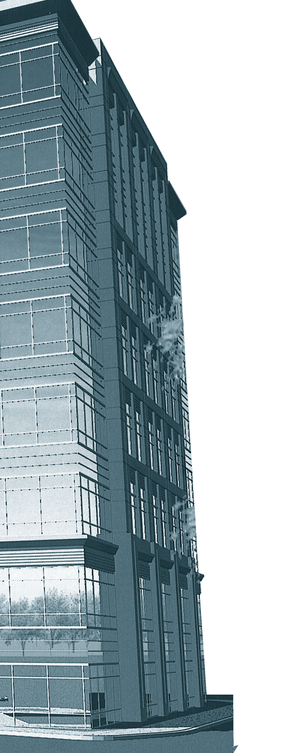
Presentation Outline
Washingtonian Center: Final Thesis Presentation
Background Information
Project Goals
Structural Depth
Existing Steel System
Redesigned Concrete System
Construction Management Breadth
Steel Structural Estimate
Concrete Structural Estimate
System Comparisons
Final Recommendation

Slide 3
Project Information
Washingtonian Center: Final Thesis Presentation
General Statistics
Name: Washingtonian Center
Location: Gaithersburg Maryland
Size: 199,164 S.F.
Function: Office Space
Levels: Eight Floors
Project Team
Owner: Washington Property Company
Architect: Wisnewski Blair and Associates LTD
Structural: Echelon Engineering
MEP: GHT Limited
Background Information
Project Goals
Structural Depth
CM Breadth
Architectural Breadth
System Comparison
Final Recommendation

Slide 4
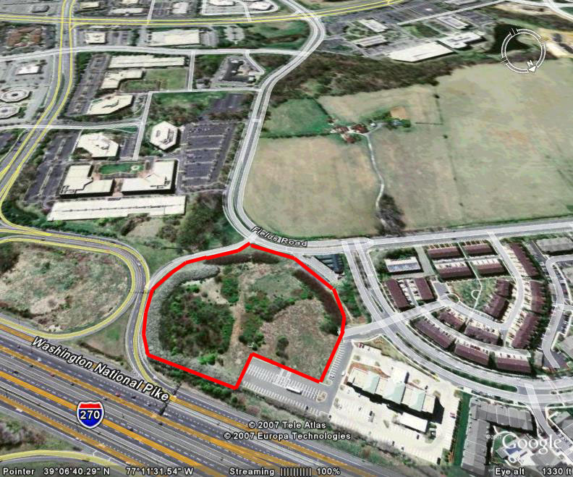
Site
Washingtonian Center: Final Thesis Presentation
Located in Gaithersburg Maryland
Previously Undeveloped Site
8 Acre Lot
Planned Development Includes Two Office Buildings and a Parking Structure
Background Information
Project Goals
Structural Depth
CM Breadth
Architectural Breadth
System Comparison
Final Recommendation

Slide 5
Thesis Goal
Washingtonian Center: Final Thesis Presentation
“Determine the Best Structural Design For the Washingtonian Center”
Goal Achieved By:
1. Redesigning the Structure Using Concrete
Increase Leasable Space By Reducing Floor-to-Floor Heights So That An Additional Floor Can Be Added Beneath The 125’ Height Restriction
2. Comparing the Redesign to the Original Steel Design
Structural Costs
Leasing Revenue
Construction Time
Architectural Considerations
Background Information
Project Goals
Structural Depth
CM Breadth
Architectural Breadth
System Comparison
Final Recommendation

Slide 6
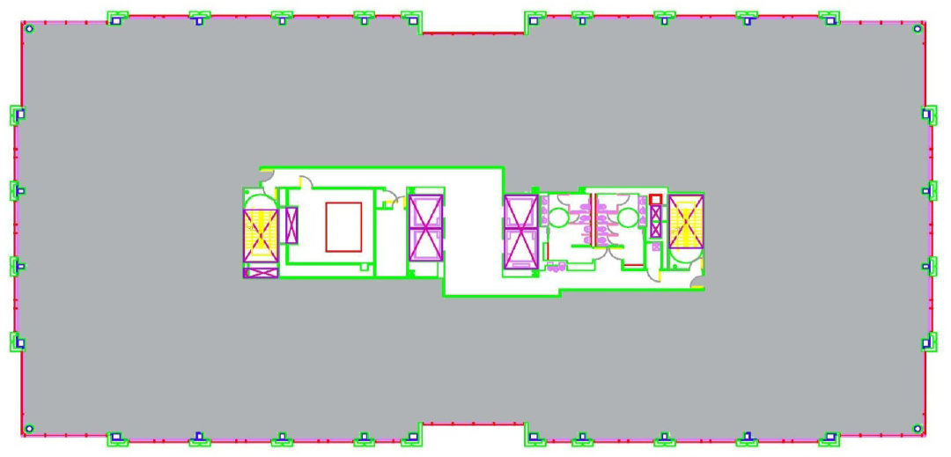
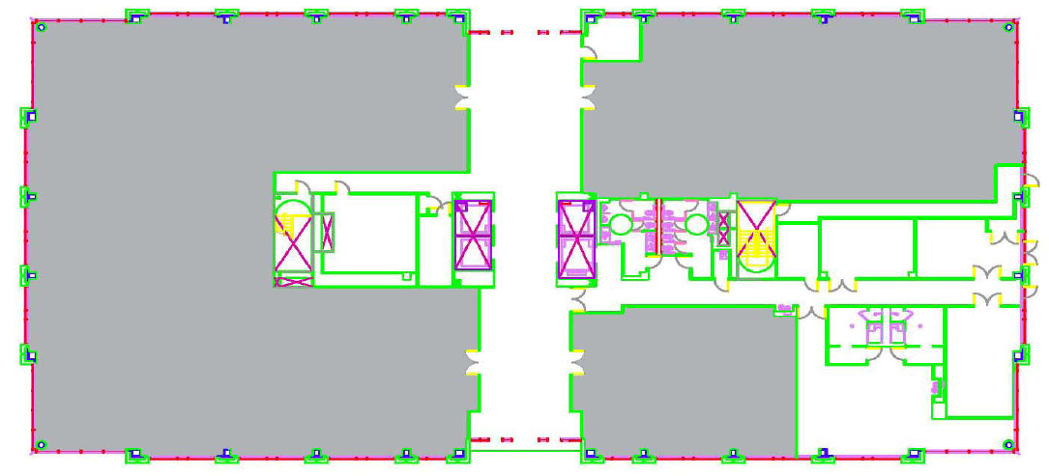
Structural Depth: Existing System
Washingtonian Center: Final Thesis Presentation
Core and Envelope Design
Leasable Space Shown in Grey
Typical Architectural Floor Plan: Floors 3-8
First Floor Architectural Plan
Background Information
Project Goals
Structural Depth
CM Breadth
Architectural Breadth
System Comparison
Final Recommendation

Slide 7
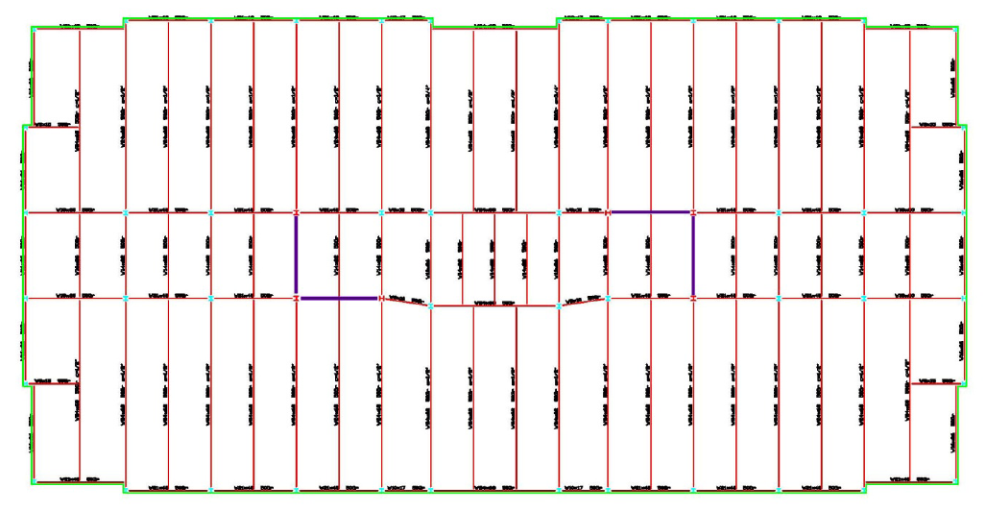
Structural Depth: Existing System
Washingtonian Center: Final Thesis Presentation
Frame:
Structural Steel Members
Outer Bays: Typically W21x44 Spanning 45’- Spaced 10’
Inner Bays: Typically W14x22 Spanning 20’- Spaced 10’
Floor System:
20 Gage Composite Steel Deck: 3” Deep, 3.25” LW Topping
Columns:
Spliced at the 4th and 7th Levels
Gravity Columns Range From W10x49-W12x96
Braced Frames
Background Information
Project Goals
Structural Depth
CM Breadth
Architectural Breadth
System Comparison
Final Recommendation

Slide 8
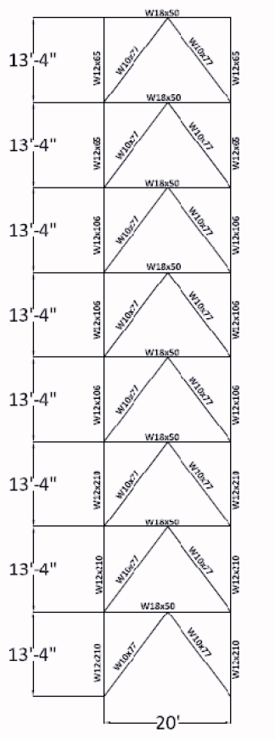
Structural Depth: Existing System
Washingtonian Center: Final Thesis Presentation
Lateral Frame:
4 Identical Concentrically Braced Chevron Frames
Located Around the Elevator Core
Lateral Columns:
Spliced at the 4th and 7th Levels
W12x210 at Base, W12x106 in Middle, W12x65 at Top
Braces:
W10x77 at all Levels
Beams:
W18x50 at all Levels
Braced Frame Locations
Braced Frame Elevation
Background Information
Project Goals
Structural Depth
CM Breadth
Architectural Breadth
System Comparison
Final Recommendation

Slide 9
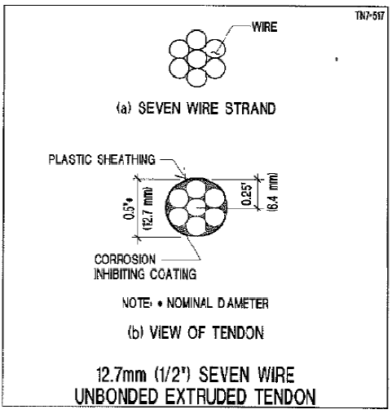
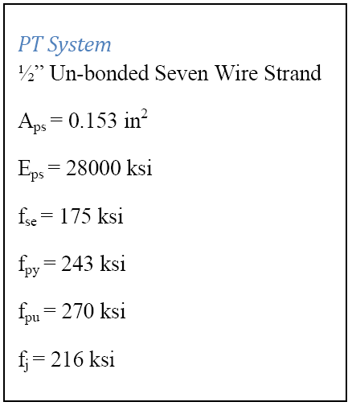
Structural Depth: PT-Floor
Washingtonian Center: Final Thesis Presentation
Design Procedure
Ram Concept was used for design
Initial Tendon numbers/spacing based on 150 psi pre-compression
Balance 75% of dead load
Add stud rails at locations of punching shear failures
Jacking Stress= 0.8fpu
Total Losses at service loading= 19%
Background Information
Project Goals
Structural Depth
CM Breadth
Architectural Breadth
System Comparison
Final Recommendation

Slide 10
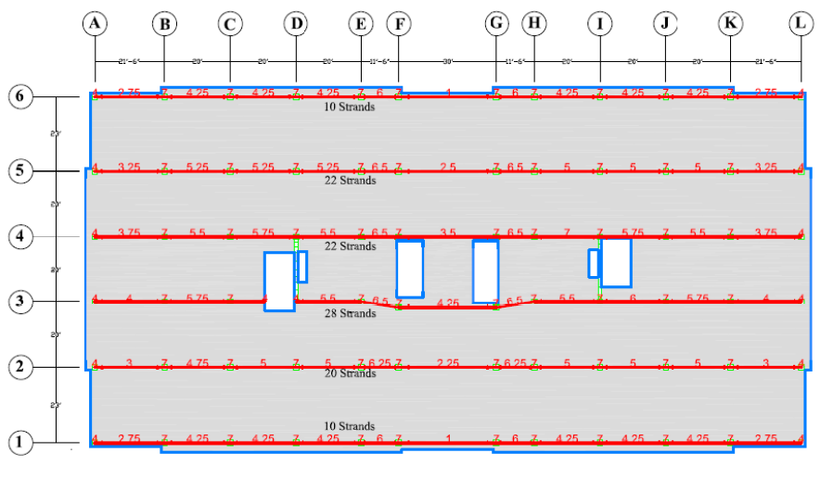
Structural Depth: PT-Floor
Washingtonian Center: Final Thesis Presentation
Banded Tendon Layout
Banded Tendons:
Initial Number Based 150 psi Pre-Compression in Band Strip
Profile Height Initially 7” Over Columns
Profile Height Initially 1” at Mid-span
Number/Profiles Altered at Mid-Span to Balance 75% of Dead Load
Additional Tendons Added at Locations of Tensile Failures
Background Information
Project Goals
Structural Depth
CM Breadth
Architectural Breadth
System Comparison
Final Recommendation

Slide 11
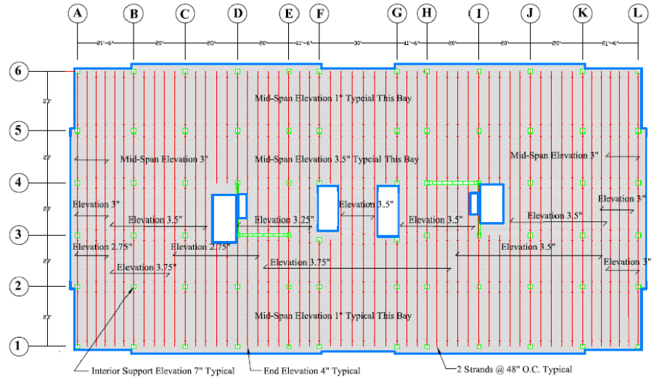
Structural Depth: PT-Floor
Washingtonian Center: Final Thesis Presentation
Distributed Tendon Layout
Distributed Tendons:
Initial Number and Spacing Based 150 psi Pre-Compression
Profile Height Initially 7” Over Columns
Profile Height Initially 1” at Mid-span
Profile Heights Altered at Mid-Span to Balance 75% of Dead Load
Additional Tendons Added at Locations of Tensile Failures
Background Information
Project Goals
Structural Depth
CM Breadth
Architectural Breadth
System Comparison
Final Recommendation

Slide 12
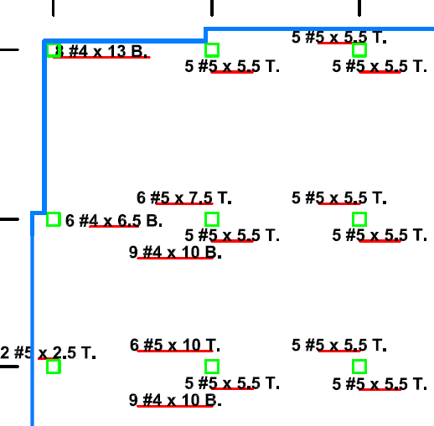
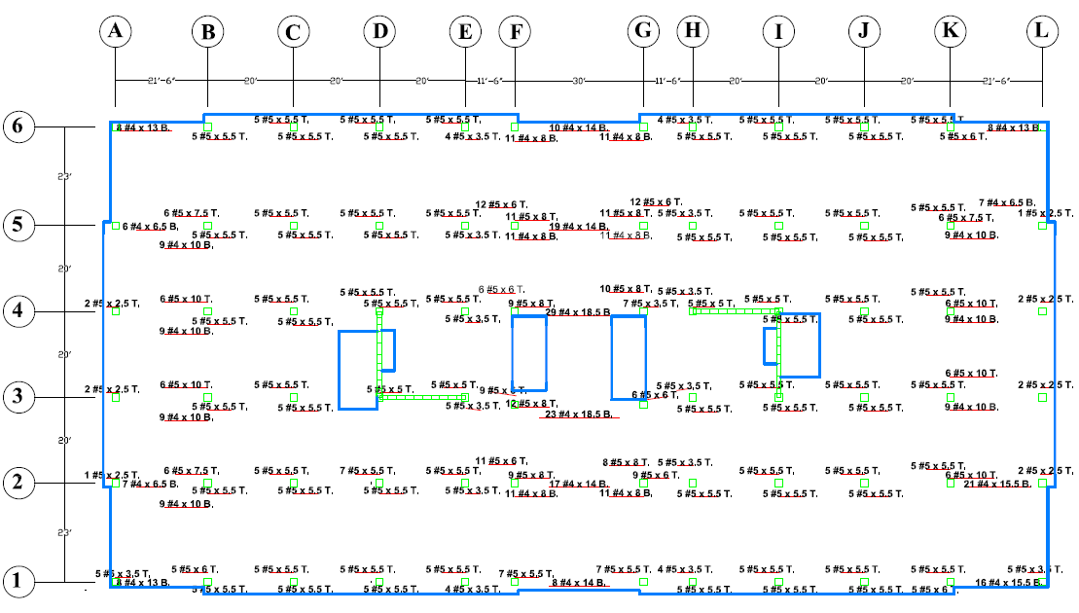
Structural Depth: PT-Floor
Washingtonian Center: Final Thesis Presentation
Mild Steel Reinforcement
Added by requirements of ACI 318-08
Top Bars: Typically #5 bars over supports extending at least 1/6th span in each direction, distributed over design strip
Bottom Bars: Typically #4 bars at mid-span extending at least 1/3rd the span, distributed over design strip
Latitude Mild Steel Reinforcement
Background Information
Project Goals
Structural Depth
CM Breadth
Architectural Breadth
System Comparison
Final Recommendation

Slide 13
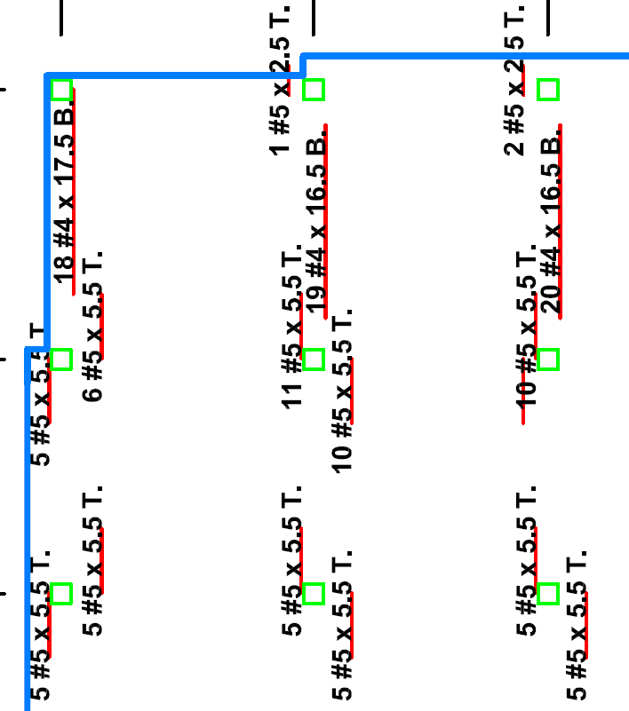
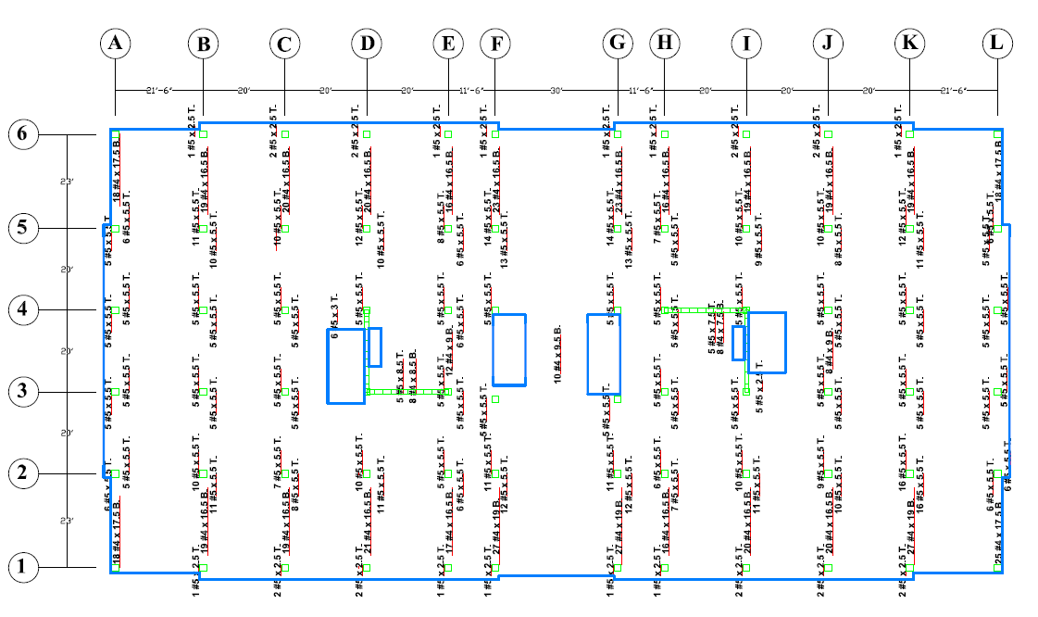
Structural Depth: PT-Floor
Washingtonian Center: Final Thesis Presentation
Mild Steel Reinforcement
Added by requirements of ACI 318-08
Top Bars: Typically #5 bars over supports extending at least 1/6th span in each direction, distributed over design strip
Bottom Bars: Typically #4 bars at mid-span extending at least 1/3rd the span, distributed over design strip
Longitude Mild Steel Reinforcement
Background Information
Project Goals
Structural Depth
CM Breadth
Architectural Breadth
System Comparison
Final Recommendation

Slide 14
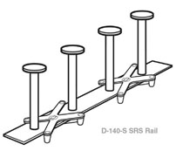
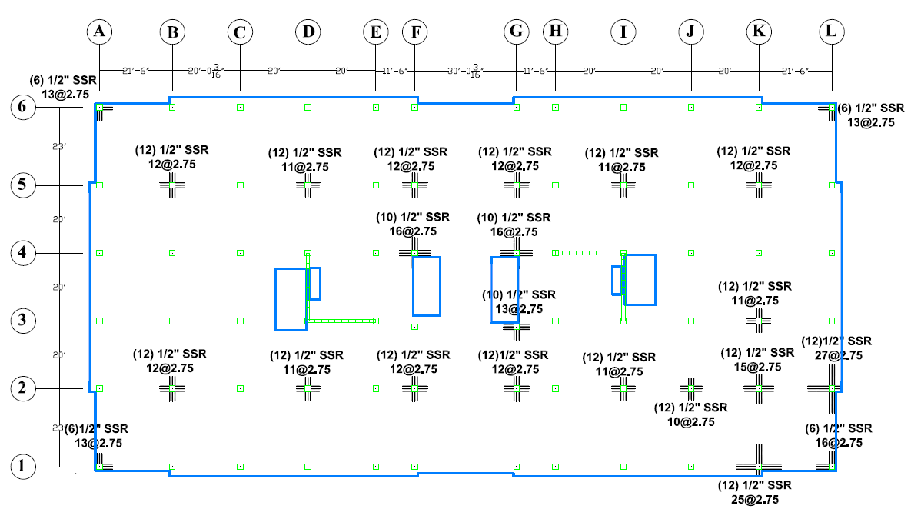
Structural Depth: PT-Floor
Washingtonian Center: Final Thesis Presentation
Supplemental Shear Reinforcement
Stud Rail Detail
Background Information
Project Goals
Structural Depth
CM Breadth
Architectural Breadth
System Comparison
Final Recommendation

Slide 15
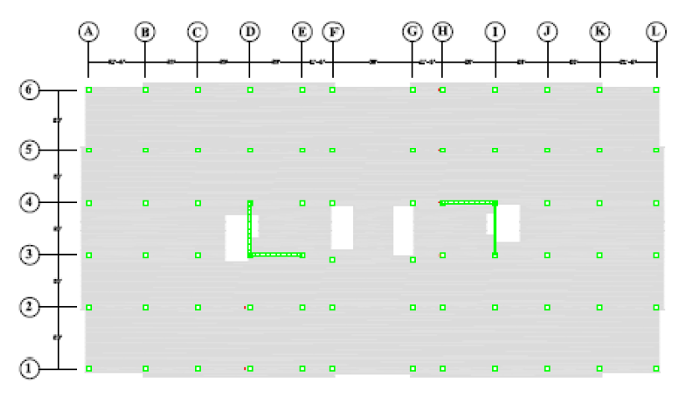
Structural Depth: Shear Walls
Washingtonian Center: Final Thesis Presentation
Designed in Etabs
Service Model Sized Walls
Cracking Factors Initially Set to 1.0
Cracked Sections Changed to 0.5
Strength Model Designed Reinforcement
Cracking Factors Initially Set to 0.7
Cracked Sections Changed to 0.35 (ACI 318-08 Section 10.10.4.1)
5000 psi concrete
Shear Wall Location
Background Information
Project Goals
Structural Depth
CM Breadth
Architectural Breadth
System Comparison
Final Recommendation

Slide 16
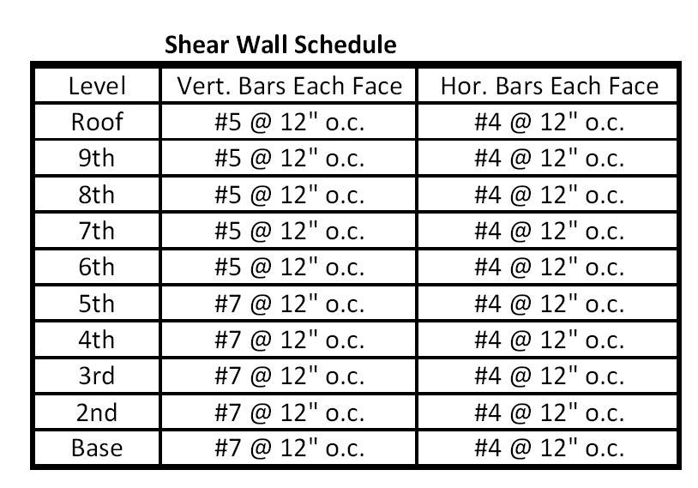
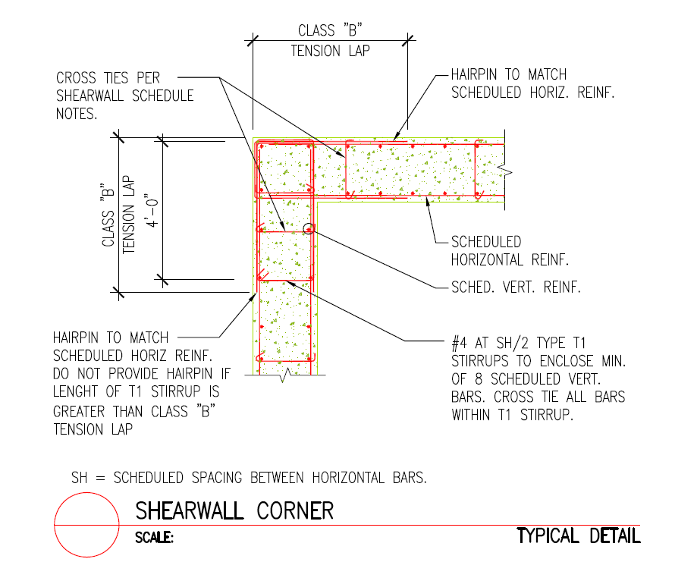
Structural Depth: Shear Walls
Washingtonian Center: Final Thesis Presentation
Background Information
Project Goals
Structural Depth
CM Breadth
Architectural Breadth
System Comparison
Final Recommendation

Slide 17
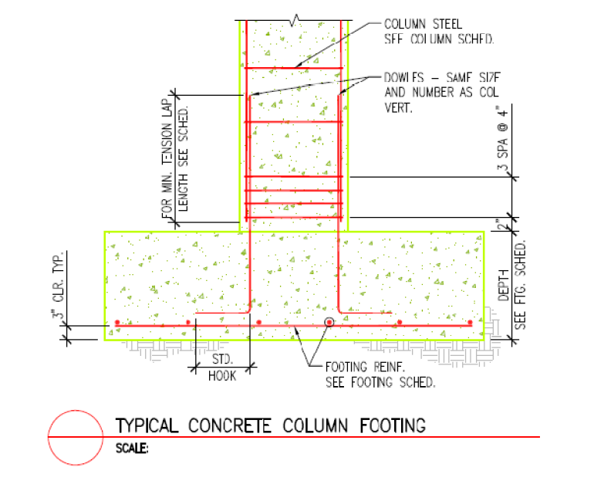
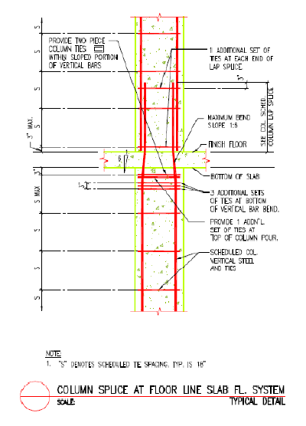
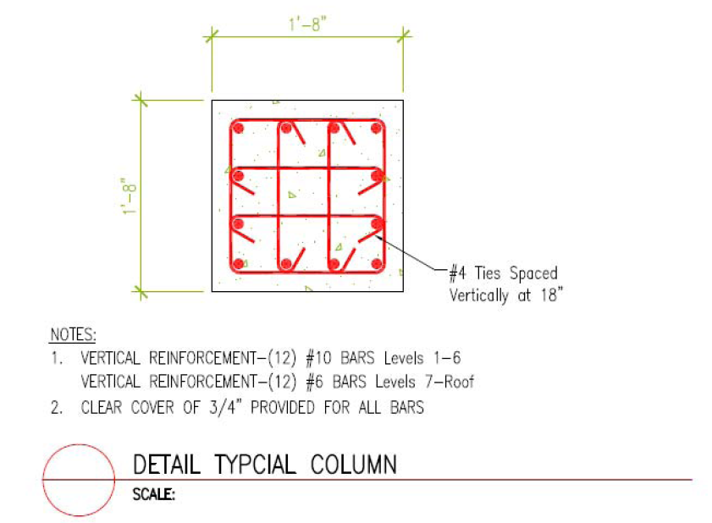
Structural Depth: Columns
Washingtonian Center: Final Thesis Presentation
All columns designed to be the same size
Loads taken from the Etabs Strength Model
Designed in PCA Column
5000 psi Concrete
Background Information
Project Goals
Structural Depth
CM Breadth
Architectural Breadth
System Comparison
Final Recommendation

Slide 18
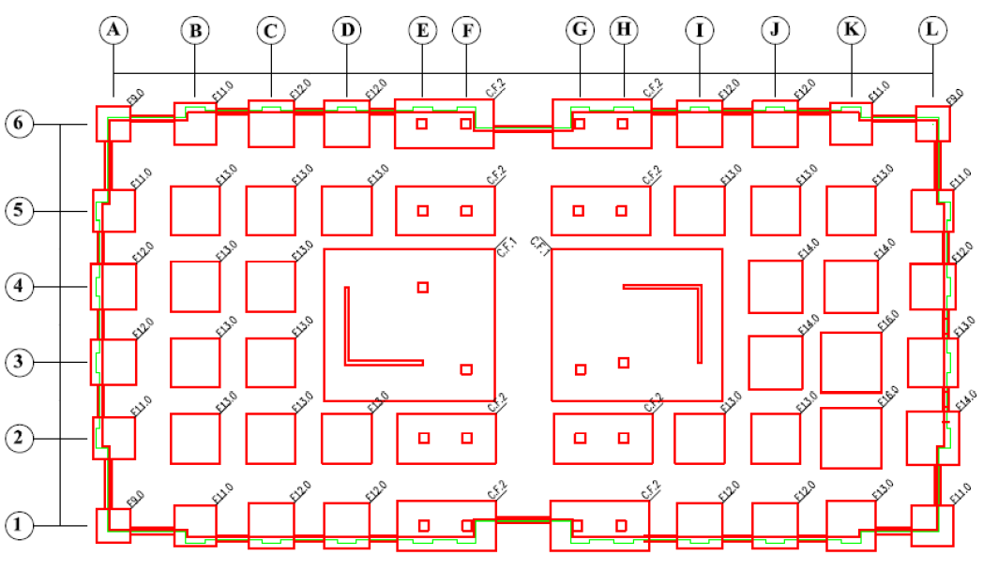
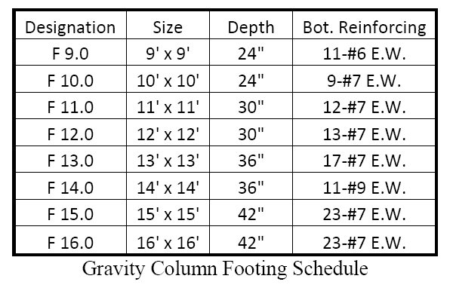
Structural Depth: Foundations
Washingtonian Center: Final Thesis Presentation
Design Procedure
Loads Taken From the Etabs Strength Model
Footings Designed Using PCA Mats
Where Individual Footings Intersected Combined Mat Footings Were Designed
Background Information
Project Goals
Structural Depth
CM Breadth
Architectural Breadth
System Comparison
Final Recommendation

Slide 19
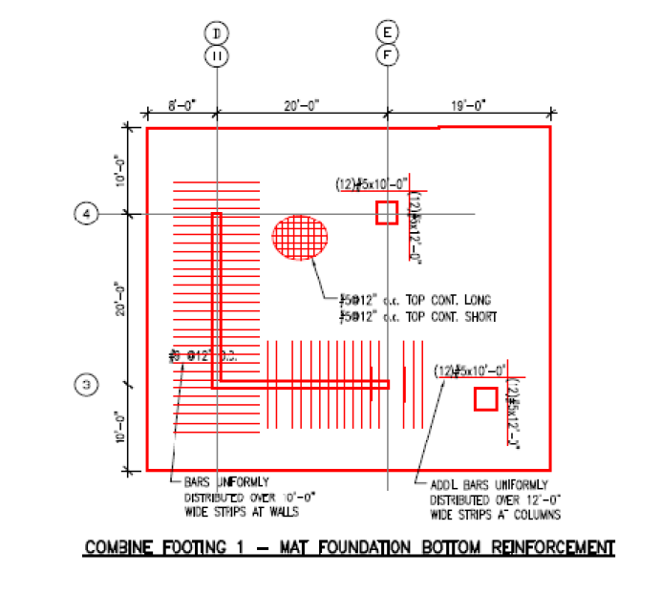
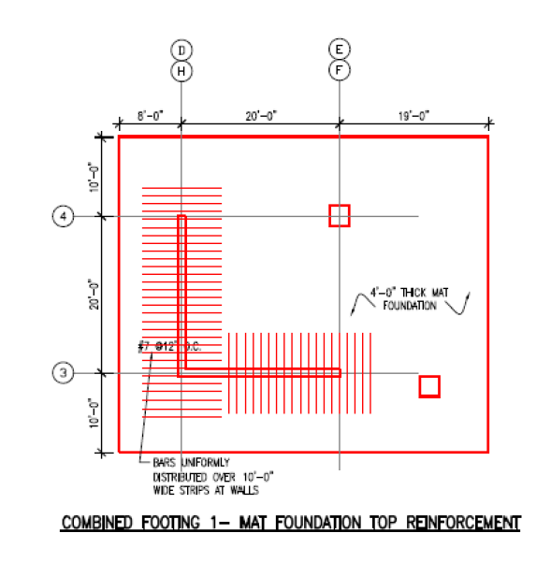
Structural Depth: Foundations
Washingtonian Center: Final Thesis Presentation
Background Information
Project Goals
Structural Depth
CM Breadth
Architectural Breadth
System Comparison
Final Recommendation

Slide 20
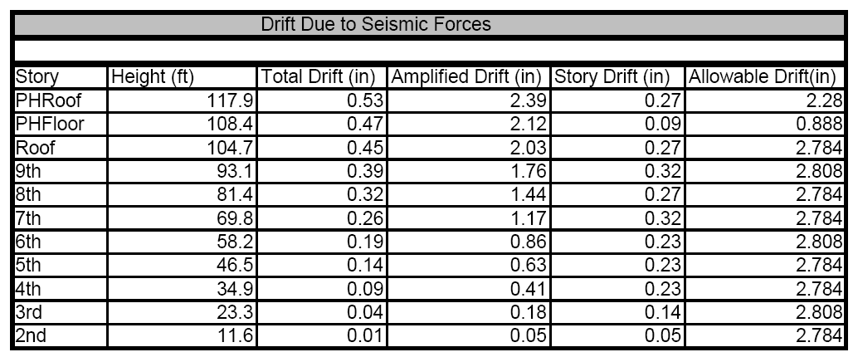
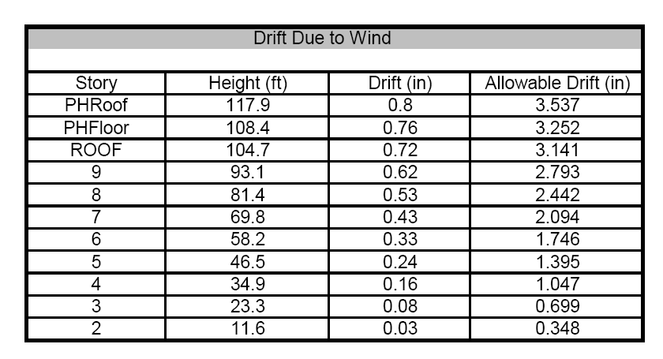
Structural Depth: Analysis
Washingtonian Center: Final Thesis Presentation
Drifts
Seismic-Allowable Story Drifts 0.02h
Wind-Allowable Building Drift h/400
Background Information
Project Goals
Structural Depth
CM Breadth
Architectural Breadth
System Comparison
Final Recommendation

Slide 21
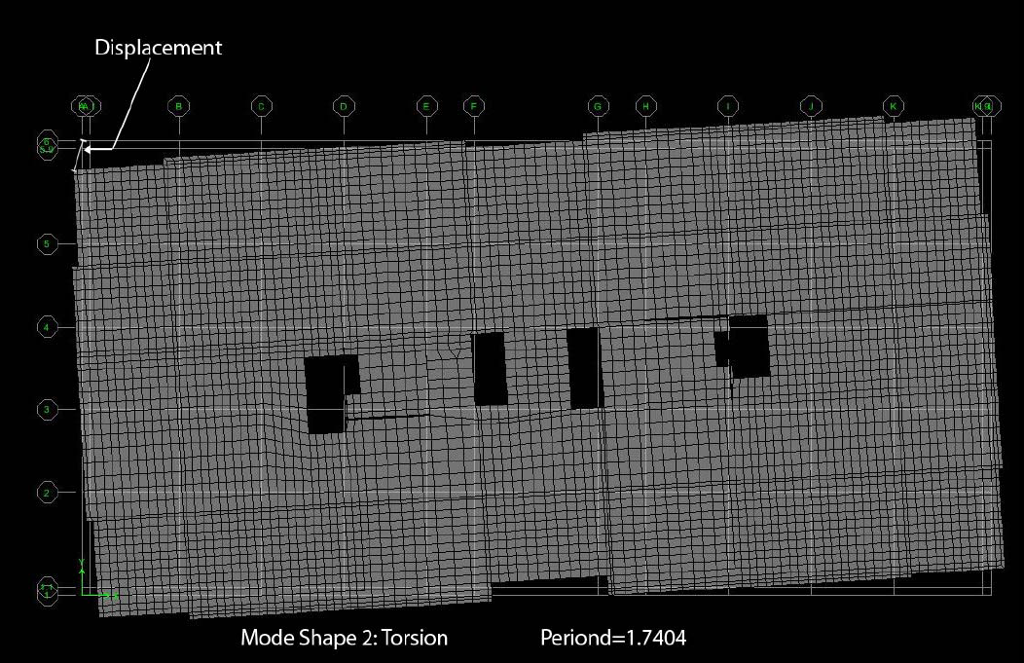
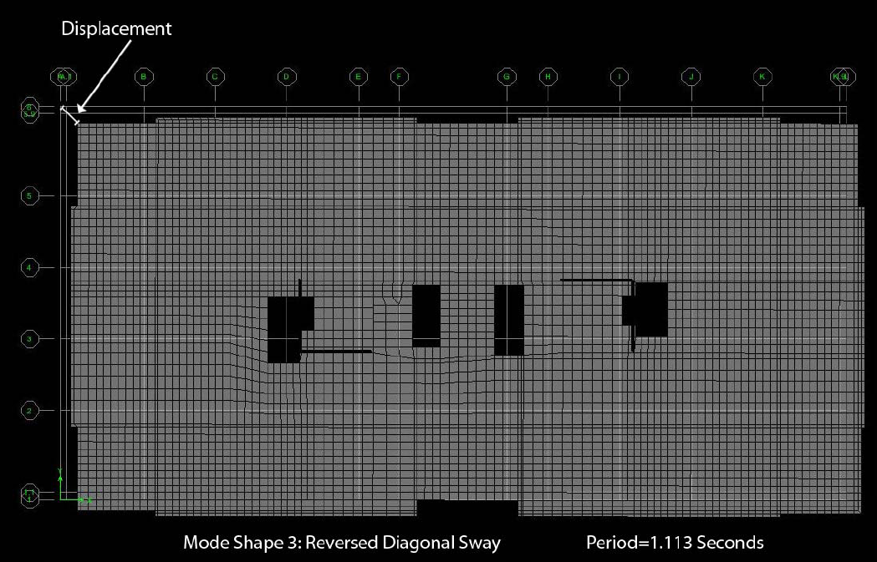
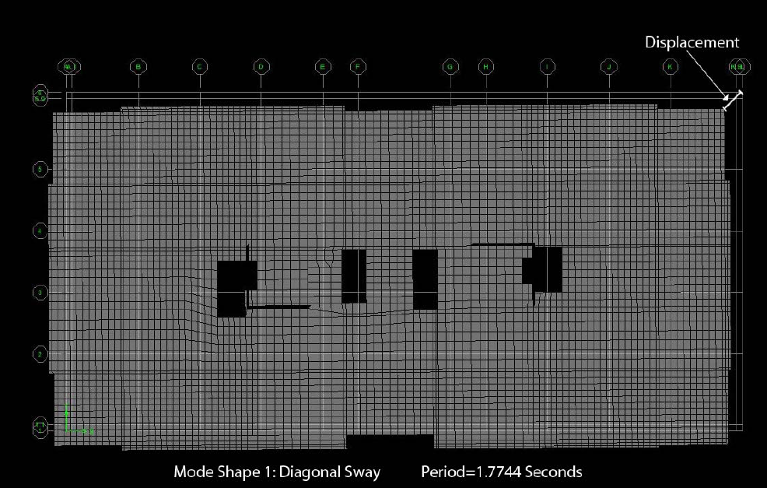
Structural Depth: Analysis
Washingtonian Center: Final Thesis Presentation
Building Modes and Fundamental Periods
Background Information
Project Goals
Structural Depth
CM Breadth
Architectural Breadth
System Comparison
Final Recommendation

Slide 22
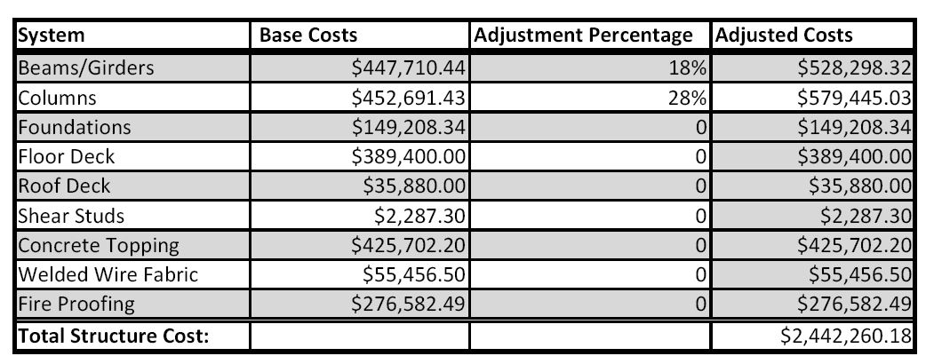
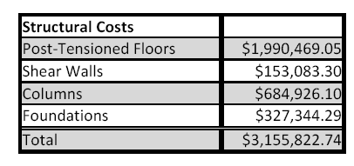
Construction Management Breadth
Washingtonian Center: Final Thesis Presentation
Cost Analysis
Done Using Material Take-Off and RS Means for Material, Labor and Equipment Costs
Concrete Design Cost Summary
Steel Design Cost Summary
Background Information
Project Goals
Structural Depth
CM Breadth
Architectural Breadth
System Comparison
Final Recommendation

Slide 23
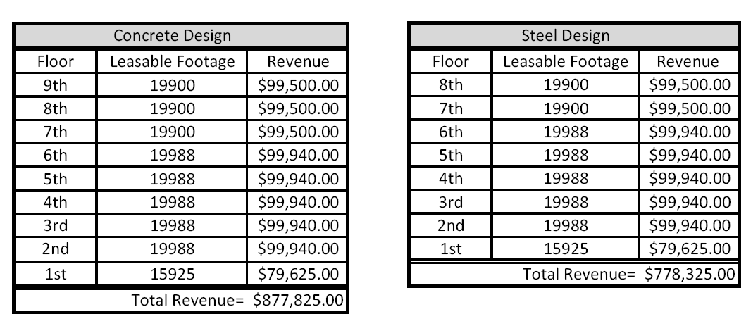
Construction Management Breadth
Washingtonian Center: Final Thesis Presentation
Revenue From Leasing Office Space
Estimate was based on rental rate of $5/ Sq. Ft. Annually
Overall System Cost Comparison
Cost Comparison Summary
Expense/Income | Steel | Concrete | Difference
Structure | $2,442,260.18 | $3,155,822.74 | -$713,562.56
Leasing Revenue/Year | $778,325.00 | $877,825.00 | $99,500.00
Background Information
Project Goals
Structural Depth
CM Breadth
Architectural Breadth
System Comparison
Final Recommendation

Slide 24
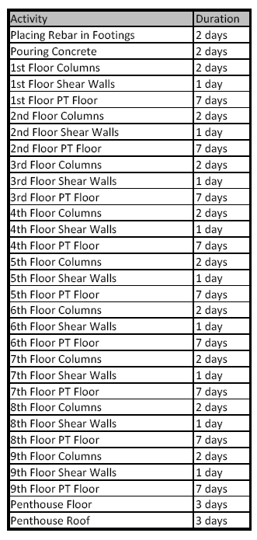
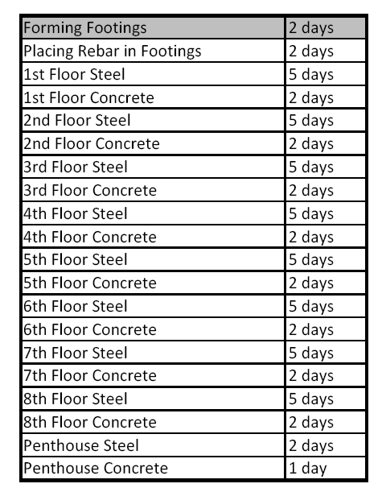
Construction Management Breadth
Washingtonian Center: Final Thesis Presentation
Concrete Construction Schedule: Total Time= 20 Weeks
Steel Construction Schedule: Total Time= 7 Weeks
Construction Scheduling
Estimated Using RS Means and Professional Consultants
Background Information
Project Goals
Structural Depth
CM Breadth
Architectural Breadth
System Comparison
Final Recommendation

Slide 25
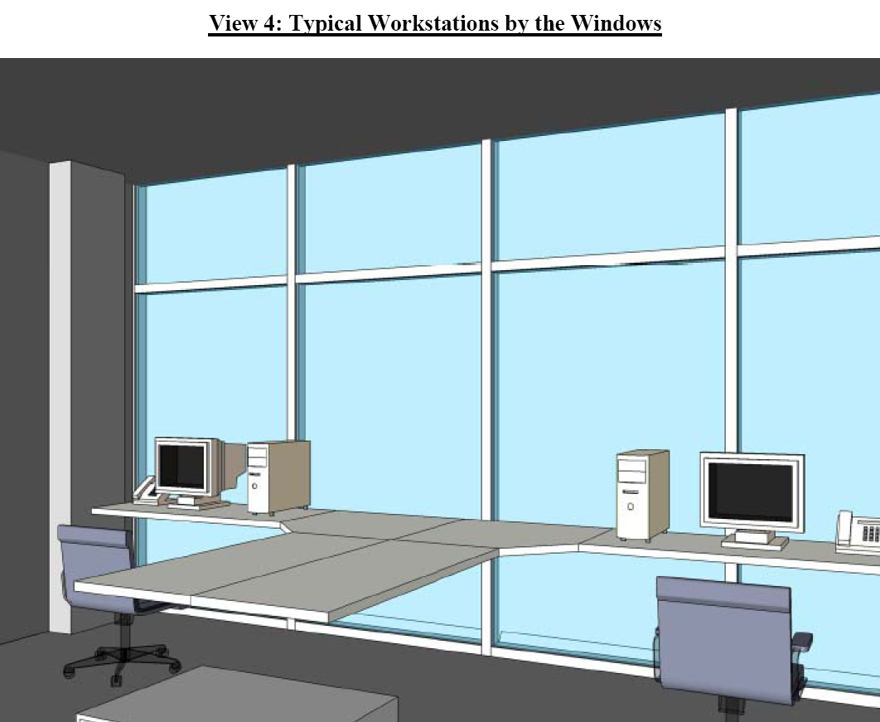
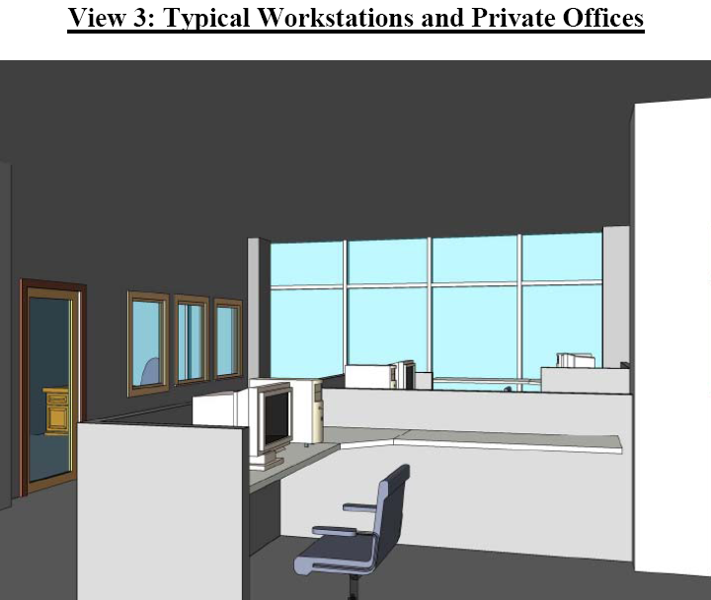
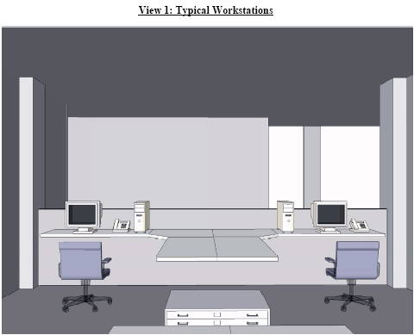
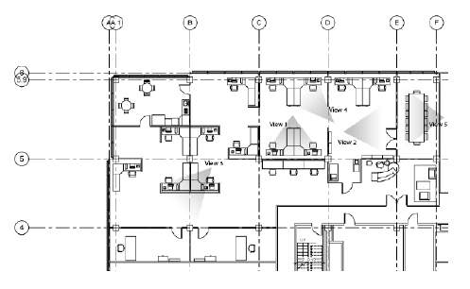
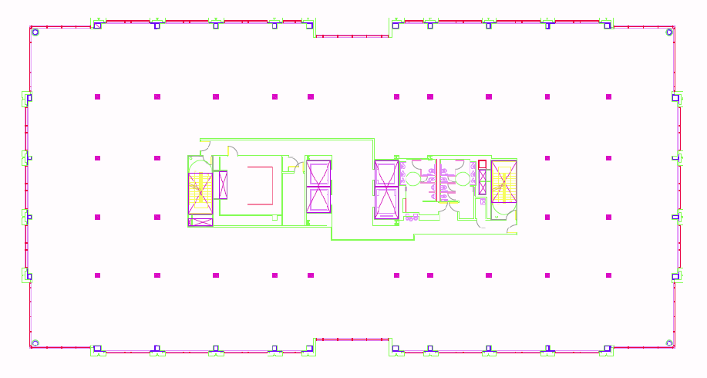
Architectural Breadth
Washingtonian Center: Final Thesis Presentation
Column Plan for Concrete Design
Furniture Plan
A Revit model of a possible interior office layout was made
Shows that the additional columns in concrete design don’t ruin the flexibility of the space
Background Information
Project Goals
Structural Depth
CM Breadth
Architectural Breadth
System Comparison
Final Recommendation

Slide 26
System Comparison
Washingtonian Center: Final Thesis Presentation
Characteristic | Steel Design | Concrete Design
Structural Cost
Leasing Revenue
Scheduling Time
Open Floor Plan
Background Information
Project Goals
Structural Depth
CM Breadth
Architectural Breadth
System Comparison
Final Recommendation

Slide 27
Final Recommendation
Washingtonian Center: Final Thesis Presentation
Although the concrete design would provide additionally leasable space, the best solution for the Washingtonian Center is the original steel design.
Background Information
Project Goals
Structural Depth
CM Breadth
Architectural Breadth
System Comparison
Final Recommendation

Slide 28
Questions?
Washingtonian Center: Final Thesis Presentation
Background Information
Project Goals
Structural Depth
CM Breadth
Architectural Breadth
System Comparison
Final Recommendation

